Slide 1
Student Segmentation |  | Duke Offering
Student Background | Career Ambition | Program | Focus | Duration
Hardcore technical - Computer science or ECE | Become a software engineer w/ ML skills or a ML engineer; or academia (M.S.) | M.S. ECE w/ ML track M.Eng ECE w/ ML track | Deep C.S. technical study including deep ML programming knowledge | 1.5-2yrs
Science, Engineering or other quantitative field (focus on non-ECE, non CS majors) | Work with ML and analytics in technology-based organizations in Product Dev’t or Engineering Services | M.Eng in Applied ML/AI/Analytics | Application of ML and analytics to solve real-world problems in technical industries | 1yr
Any | Become a data analyst/scientist, or apply data science in chosen field | Master in Interdisciplinary Data Science | Broad spectrum data science hard and soft skills | 2yrs

Slide 2
Program Differentiating Aspects
Career aspirations of graduates would include the implementation of ML and AI solutions in technology-based organizations
Positions for graduates would focus on Product Development or Engineering Services that utilize ML and AI rather than ML or AI products themselves
Program focus would involve building competencies through real-world applications targeting specific industries
It is anticipated that both a technology track and a technology management track would be available through the choice of electives but all students would gain technical proficiency
Program would be designed for incoming students from non-ECE/CS majors with sufficient technical backgrounds
Deep programming, algorithm and math background would not be required for incoming students, rather sufficient programming skills to utilize tools and manipulate data would be sufficient

Slide 3
Layers of Analytics Know-How
Industry-specific Application
Merging ML expertise w/ domain expertise, delivering products of value
Implementation Practices
Problem formulation, Data science process, logging & data lineage, productionizing models
Duke M.Eng in Applied AI/ ML/ Analytics
Tools & Systems
Real-world ML toolset, ML infrastructure, Big Data analytics tools
Typical university graduate CS/ML programs
ML Programming
Programming implementation of ML
Typical online trainings
ML Theory
Mathematical derivation of ML algorithms

Slide 4
Curriculum Ideas (draft) Validate curriculum with an industry steering committee
Courses |  | Content | Expected Outcomes
Semester 1 | Programming for Analytics | Hands-on computation techniques for data analysis and modeling (programming + tools) | Competent level of numerical programming Able to perform basic data analysis and modeling on real-world problems Understanding of ML theory and algorithms Understanding of modeling process and applications in industry
 | Intro to Analytics Modeling | Data science process, primary modeling techniques and tools, industry case examples
 | Machine Learning | Theory, programming and implementation of machine learning models
 | Business Core 1 (MEND 570?) | Management of high-tech industries
 | Elective 1
Semester 2 | Data Analysis and Visualization Tools | Tools and methods for analyzing and visualizing data (programming + tools + process) | Ability to apply common analytics and modeling tools, including big data and deep learning tools Specialized industry expertise from electives Experience applying skills to a real-world industry challenge
 | Analytics Product Development (Business Core 2) | Business cases and product development cycle for analytics products
 | Elective 2
 | Elective 3
 | Capstone Analytics Practicum | Industry-sponsored analytics practicum
Semester 3 | Industry Internship |  | Experience working in an analytics team

Slide 5
Electives Ideas (draft)
Potential Courses
Industry-Specialized Electives (Technology or Technology Mgmt track) | Machine Learning in Healthcare
 | Machine Learning for FinTech (shared)
 | Modeling with Weather and Climate Data
Technology track | Deep Learning & Computer Vision
 | Distributed Analytics for Big Data (Hadoop/Spark) (shared?)
 | Graph Analytics (shared?)
 | NLP and Text Analytics
 | Time Series Data Analysis (shared?)
 | Secure Software Development (shared)
Technology mgmt. track | Product Management (EGRMGMT 590)
 | Design Thinking & Innovation (EGRMGMT 590)
 | Business Applications for Analytics

Slide 6
Discussion topics
Duke objectives for program
Timing
Curriculum
Core
Shared courses – ECE or MEM
Electives
Practicum
Faculty
Target demographic
Admissions requirements
Program marketing
Program name
Applied AI / ML / Analytics

Slide 8
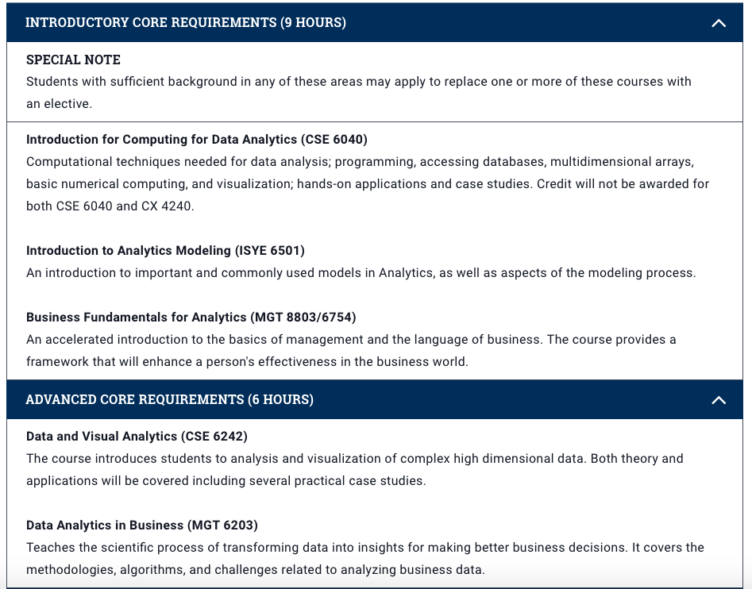

Slide 9
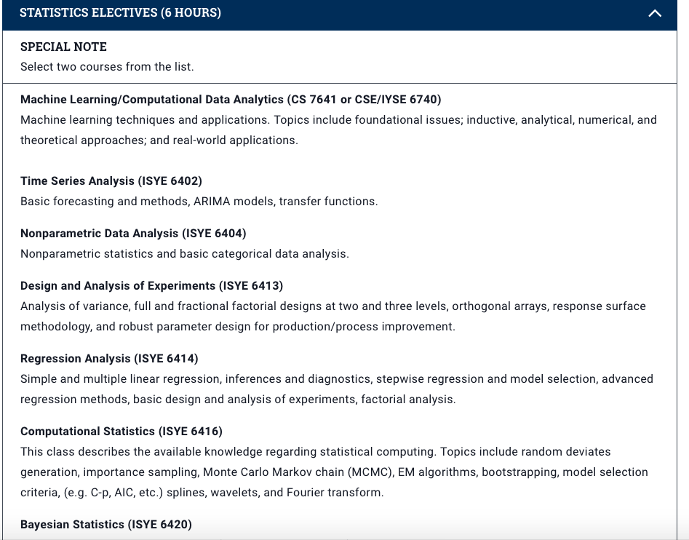

Slide 10
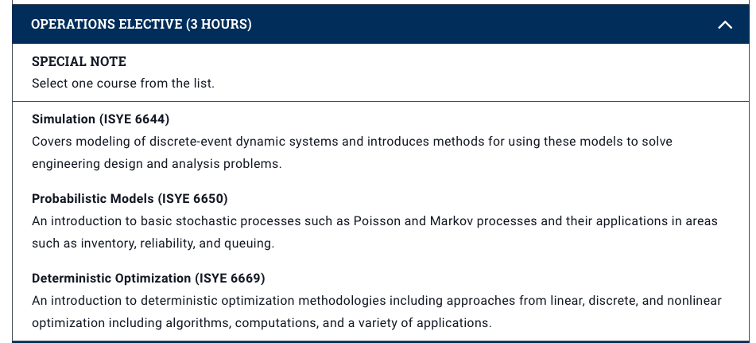

Slide 11
